Slide 1
www.MINEPORTAL.in
ONLINE TEST SERIES FOR
DGMS COAL/METAL FIRST/SECOND CLASS EXAM
GATE MINING EXAM
OVERMAN EXAM TEST
MINING INSPECTOR EXAMS
COAL INDIA MTs & OTHER PSUs EXAMS
FREE STUDY MATERIAL & VIDEO LECTURES
MINING JOBS NOTIFICATIONS
www.mineportal.in Call/Whatsapp-8804777500 www.fb.com/mineportal.in

Slide 2
Working Principle of a Jack Hammer Drill

Slide 3
Drilling :
Drilling is mostly employed in mining for the placement and efficient use of explosives.
It is also used for exploration, in fixing rock bolts, in stabilizing slopes and to test foundations.
Drilling is predominantly used in underground mines for the placement of roof bolts.
Production drilling refers to the operation in which holes are used for the placement of explosives.

Slide 4
Operating Components of the system:
Drill : It acts as prime mover that converts the original form of energy into mechanical energy to actuate the system.
Drill rod (or drill steel, stem or pipe) : It transmits the energy from prime mover to the bit or applicator.
Bit : It is the applicator of energy attacking the rock mechanically to achieve penetration.
Circulation fluid: It cleans the hole, cools the bit, stabilizes the hole and supports the penetration through removal of cuttings.

Slide 5
Drilling Methods:
Based on the energy distribution for rock fragmentation, drilling methods are classified as:
Rotary Drilling
Percussive Drilling
Rotary Percussive Drilling

Slide 6
Rotary Drilling:
Employed in exploration, generally for soft to medium hard rocks and soil.
Used to penetrate overburden before diamond drilling.
Energy is transmitted via drill rod, which rotates at the same time as the drill bit is forced down by high feed force.
Lowest costs are obtainable in soft rock with rotary drag bit and medium hard rock with rotary roller bit.

Slide 7
Percussion and Rotary-Percussion Drilling:
Both are used for non coring drilling operations in shallow holes and medium to hard rocks.
Rotary-Percussion drilling is employed in medium to hard rocks.
Percussion drilling is generally used in very hard rocks.
Both conventional top hammer percussion drills (percussion energy is transmitted along drill rod string) and down the hole percussion drills (drill follows the bit down the hole) are used.

Slide 8
Rock drills classification based on application of energy to rock
Percussive
Top-Hammer
Down-the-hole
Rotary
Crushing
Rock Drills
Shearing

Slide 9
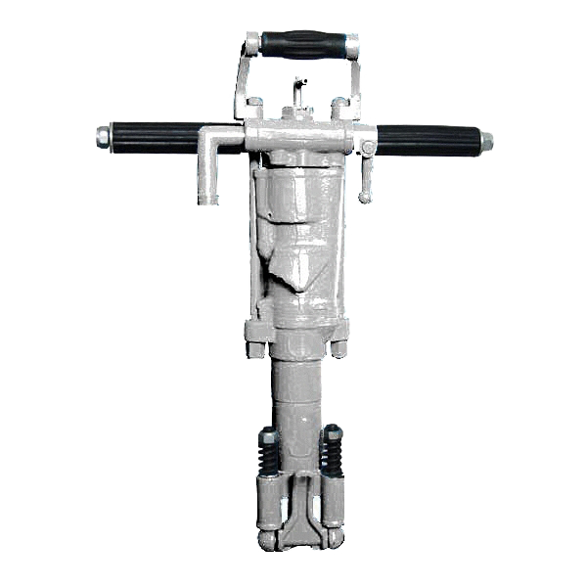
Jack Hammer Drills :
A Jackhammer drill is a pneumatic or electro-mechanical tool that combines a hammer directly with a chisel.
Hand-held jackhammers are typically powered by compressed air, but some use electric motors.
Larger jackhammers, such as rig mounted hammers used on construction machinery, are usually hydraulically powered. They are usually used to break up rock, pavement, and concrete.

Slide 10
Working principle :
A jackhammer operates by driving an internal hammer up and down.
The hammer is first driven down to strike the back of the bit and then back up to return the hammer to the original position to repeat the cycle.
The bit usually recovers from the stroke by means of a spring.
The only energy involved in making a jackhammer pound up and down is supplied from an air hose. The hose is made of especially thick plastic, which carries high-pressure air from a separate air-compressor unit powered by a diesel engine.

Slide 11
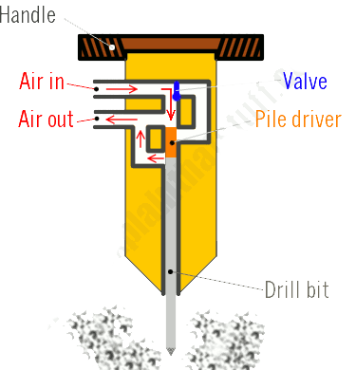
When the worker presses down on the handle, air pumps from the compressor into the jackhammer through a valve on one side.
Inside the hammer, there's a circuit of air tubes, a heavy pile driver, and a drill bit at the bottom.
First, the high-pressure air flows one way round the circuit, forcing the pile driver down so it pounds into the drill bit, smashing it into the ground.

Slide 12
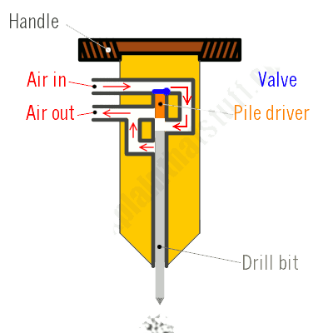
A valve inside the tube network then flips over, causing the air to circulate in the opposite direction.
Now the pile driver moves back upward, so the drill bit relaxes from the ground.
A short time later, the valve flips over again and the whole process repeats.
The upshot is that the pile driver smashes down on the drill bit over 25 times each second, so the drill pounds up and down in the ground around 1500 times a minute

Slide 13
Types of Jack Hammer Drills :
Pneumatic : Jackhammer that uses compressed air as the power source. The air supply usually comes from a portable air compressor driven by a diesel engine.
Electromechanical or Electro pneumatic : They are useful for locations where access to a compressor is limited such as inside a building or a crowded construction site. They require an external power source, but do not require a compressor.
Hydraulic : Hydraulic tools are particularly used in mines where there is an explosion risk (such as underground coal mines), since they lack any high-power electrical circuitry that might cause a triggering spark.

Slide 14
Uses of Jack Hammer Drills :
A full-sized portable jackhammer is impractical for use against walls and steep slopes, except by a very strong man, as the user would have to both support the weight of the tool, and push the tool back against the work after each blow.
A technique developed by experienced workmen is a two-man team to overcome this obstacle of gravity: one man operates the hammer and the second assists by holding the hammer either on his shoulders or cradled in his arms. Both use their combined weight to push the bit into the workface.

Slide 15
Down-the-hole drilling :
It is a rock penetration system in which the hammer and its impact mechanism operate down the hole.
The DTH hammer is one of the fastest ways to drill hard rock. The fast hammer action breaks hard rock into small flakes and dust and is blown clear by the air exhaust from the DTH hammer.
The drills such as ‘down-the-hole drill’, ‘in-the-hole-drill’ are referred as DTH drills.

Slide 16
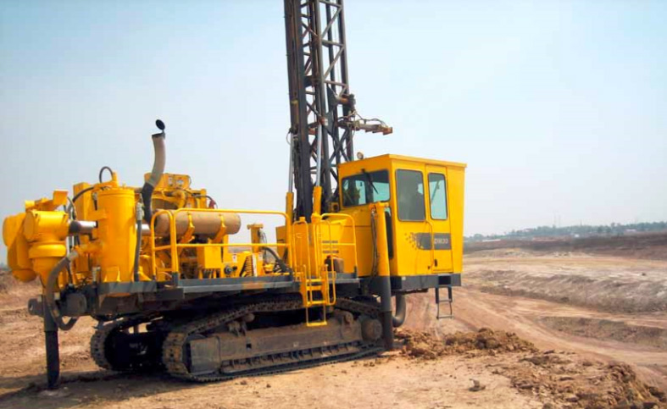
A DTH Drill

Slide 17
Working of a DTH drill :
In DTH drilling, the percussion mechanism commonly called the hammer is located directly behind the drill bit.
The drill pipes transmit the necessary feed force to hammer.
The drill pipes are added to the drill string successively behind the hammer as the hole gets deeper. The piston strikes the impact surface of the bit directly, while the hammer casing gives straight and stable guidance of the drill bit.
The impact energy does not have to pass through any joints at all. The impact energy therefore is not lost in joints allowing for much deeper percussion drilling.

Slide 18
Since the drill must operate on compressed air and tolerates only small amounts of water, cuttings are flushed either by air with water-mist injection, or by standard mine air with a dust collector.
This is very simple method for the operators for deep and straight hole drilling. In surface mines 85–165mm (3.4–6.5 inches) hole diameters is the usual range.
With recent advances in technology DTH hammers and bits can now be operated to run at up to 500Psi, increasing the Rate of Penetration (ROP)

Slide 19
Drill rods of a DTH drill and drill bit

Slide 20
Uses of DTH Drills :
DTH drilling is used in the construction industry to produce piles into rock, also water wells, and drilling bores for geothermal ground source heat pumps.
In mining, DTH drills are used to drill holes for explosives in Open Pit mining, Where the drill operator will drill several holes, then fill with explosives and detonate to lift rock allowing access to ore body.

Slide 21
Comparisons :
DTH drills differ from the conventional drills by virtue of placement of the drill in the drill string.
The DTH drill follows immediately behind the bit into the hole, rather than remaining on the feed as with the jackhammers.
Thus, no energy is dissipated through the steel or couplings, and the penetration rate is nearly constant, regardless the depth of the hole.

Slide 22
THANKS Presented by : 11108EN059 to 69

